Slide 1
WELCOME TO THE BONN PROCESS.
An introduction to the national processes for national contact points.

Slide 2
Are you involved in...
Youth work offers at local level?
Inclusive youth work targeting all young people in their diversity?
Quality development in your work?
Networking and co-operation with colleagues and partners?
Partnering up with actors from other sectors beyond youth work?
Making youth work seen, heard and recognised?
Bringing innovation to your practice and tackling crisis and challenges?
Generating more political support for youth work?

Slide 3
Do you want to...
Strengthen and develop youth work in your country?
Improve the situation of young people and youth work?
Bring the relevant stakeholders in your country together and support their networking?
Help your youth work community of practice make use of existing political backing?

Slide 4
Then the
Bonn Process
is for you.

Slide 5
The Bonn Process is for you!
The Bonn Process
Wants to strengthen and develop youth work all over Europe
Covers eight thematic fields
Is the implementation process of the European Youth Work Agenda (EYWA)
Is there for the entire youth work community of practice
The youth work community of practice comprises everybody who plays an active role in and for youth work at all levels, from local to European, such as:​
Youth workers and youth leaders​
Youth work organisations​
Youth work managers, project carriers, trainers​
Researchers, educators of youth workers​
Local communities and municipalities​
National Agencies for Erasmus+ Youth and European Solidarity Corps​
Youth representations and young people​
Youth policy-makers

Slide 6
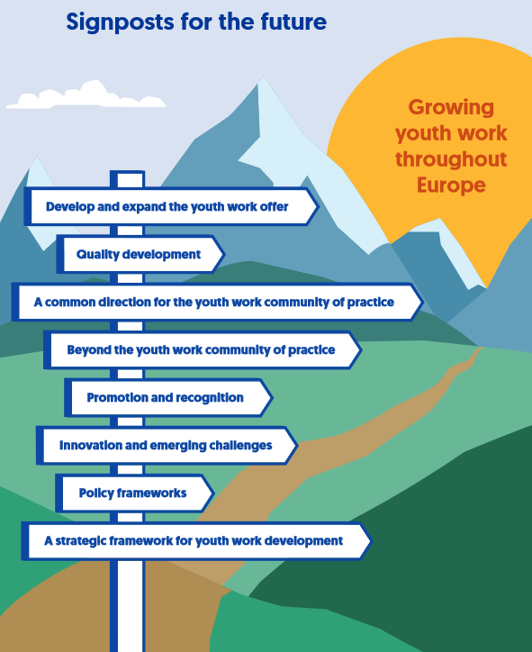
The Bonn Process is for you!
As a strategic framework for strengthening and further developing youth work, the EYWA and the Bonn Process aim at:
Better aligning the commitment of the different stakeholders in the youth work community of practice​​
Strengthening connections and co-operation within and between all levels of the youth work community of practice​​
Ensuring a more strategic and co-ordinated approach ​​
Strengthening framing conditions for youth work

Slide 7
Political background: The European Youth Work Agenda
The EYWA was developed in 2020 as a new strategic framework to further develop and strengthen youth work
Developed during the German Presidency of the Council of the EU and the German Chairmanship of the Committee of Ministers of the Council of Europe (2020)
Political basis in European Union and Council of Europe documents, including Council Resolution for a framework to establish a European Youth Work Agenda (November 2020)
Engagement of the Youth Work community of practice: Agenda implementation process -> Bonn Process

Slide 8
How is the Bonn Process implemented at national level?
Implementation has progressed in some countries through the development of
Working groups
Meetings
Co-operation of relevant national stakeholders
Activities for the national youth work field
Strategies and roadmaps
Mapping exercises
Thematic priorities

Slide 9
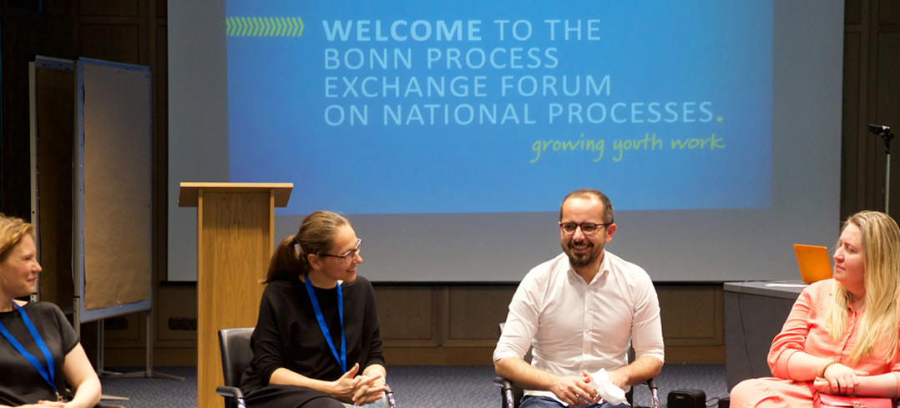
What is important when setting up a fruitful national process?
Creating a national contact point/co-ordinating body/working group to plan and start implementing the process
Receiving political support from decision-makers
Developing aims and an action plan/work plan
Developing a communication plan
Implementing mappings or gathering knowledge on the situation of youth work at national level
Providing opportunities to exchange on practice examples
Strengthening commitment from all actors and partners/co-creating developments
Reshaping the framing of ongoing activities and underlining the connection to the Bonn Process

Slide 10
Who is/should be actively involved in the national process?
National contact points
National youth ministries/authorities
National Agencies for the EU youth programmes (if one exists)
Relevant stakeholders in the youth work community of practice

Slide 11
How can a national contact point support the national process?
Potential role of a national contact point:
To ensure communication about the Bonn Process with national actors
To ensure participation of national actors
To encourage implementation of activities by the national actors
To implement measures and activities of the national action plan/work plan, develop content for events, publications, mappings, etc., and monitor the national action plan/work plan
To facilitate national thematic priorities
To transfer information between national and European levels
To keep up to date through newsletters/partners/meetings
To carry out practical management work
The role of the national contact point should be based on a mandate and contract.

Slide 12
How can national youth ministries/authorities support the national process?
Potential role of the national youth ministry/authority:
To have a good understanding of the Bonn Process and share its aim to strengthen youth work development
To provide political support to the national process and long-term support to youth work development as an ally (within the community of practice)
To provide financial support to the implementation of the national process
To appoint a national contact point and create the budgetary basis for it in the ministry
To create (in co-operation with the community of practice) a national working group for the Bonn Process
To set national priorities
To maintain international co-operation and exchange with youth ministries from other countries
To raise political awareness of the EYWA and mention the Bonn Process/EYWA in various political documents
To give a clear mandate to National Agencies to support the national process by mobilising the capacities and resources of the EU youth programmes as instruments for the Bonn Process (in those countries where they exist)

Slide 13
How can National Agencies for the EU youth programmes support the national process?
Potential role of National Agencies for Erasmus+ Youth and European Solidarity Corps:
To provide financial support to European activities in the context of the Bonn Process (projects to develop youth work)
To support funded projects as regards their content and strategic development
To ensure transfer between the European debate and national implementation
To provide thematic impetus to the European debate/debate in Europe (through events, publications) and at national level
To actively contribute to the national process, inform about opportunities available under the EU youth programmes and – if necessary – act as national contact point
To facilitate networking between various actors or groups within the community of practice
To act as communicator for the EYWA by raising awareness among beneficiaries about it, providing translated, understandable and accessible materials, and transferring knowledge
To make visible funded projects related to the Bonn Process

Slide 14
How can the youth work community of practice support the national process?
Role of the youth work community of practice:
To act at the operational level and implement activities to develop youth work further
To involve young people and co-create with them to capture their concerns and requirements
To generate connections, exchange, and co-operation within the youth work community and beyond
To advocate (for youth work and its development) in the role of aware experts and ambassadors and to get involved in decision-making processes
To maintain a proactive, future-oriented and strategic mindset and practice
To generate data for knowledge-gathering/research/evaluation surveys
To maintain ownership and consider the famous 3rd EYWC quote “Don´t ask what the Bonn Process can do for you, but what you can do for the Bonn Process”
To show solidarity and support each other

Slide 15
How does the European level support the national processes?
Current offers
Yearly Bonn Process Exchange Forum on National Processes
Regular digital “Bonn Process Coffee Talks on National Processes” for contact persons for the national processes
Supporting materials
News articles about national processes on the website www.bonn-process.net
Yearly Bonn Process Meet-up for the entire youth work community of practice and related thematic co-operation and platform
Upcoming needs-based ideas related to support
More exchange and networking formats
Overviews and information about existing support opportunities, activities, and measures
In-depth and theme-specific focused events and meetings

Slide 16
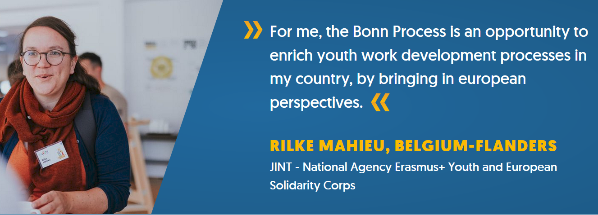
Testimonial

Slide 17
More information
More information about the national processes and support for national processes on the Bonn Process Website www.bonn-process.net
Bonn Process Factsheet
Final Declaration of the 3rd European Youth Work Convention and Factsheet Declaration
European Youth Work Agenda Factsheet and explainer video "What is the European Youth Work Agenda?"
Political basis by EU and Council of Europe documents: Council Resolution for a framework to establish a European Youth Work Agenda; Council of Europe Youth Sector Strategy 2030

Slide 18
Contact
European Service Centre for the Bonn Process
at JUGEND für Europa (National Agency for the EU programmes Erasmus+ Youth, Erasmus+ Sport and the European Solidarity Corps in Germany)
Website www.bonn-process.net and Bonn Process Newsletter
Facebook; Instagram; Youtube
More information about the European Service Centre for the Bonn Process
Contact: bonn-process@jfemail.de | Team: Alicia Holzschuh and Elke Führer

